Slide 1
MISSING CHILD DISTINGUISHING FRAMEWORK USING DEEP LEARNING AND SVM
IV Year B.Tech – Mini Project Review (Review-1)
Team Members Details
L.Vaishali 20N31A6932
M.Poojitha 20N31A6934
T.Sai Kumar Reddy 20N31A6954
IV Year B.Tech – CSE(IOT)
Under the Guidance of
Mrs.P.Satyavathi
Asst.professor
Emerging Technologies

Slide 2
Outline
Abstract
Introduction
Existing System
Proposed System
Difference between Existing and Proposed
Literature Review

Slide 3
Abstract
This project presents a novel approach to assist law enforcement agencies and communities in locating missing children by leveraging deep learning and Support Vector Machines (SVM).
SVM & deep learning for distinguishing and categorizing distinguishing features in images of missing children.
We propose a robust framework that automates the process of extracting and analyzing distinguishing attributes like unique identifiers from images.
Enabling faster and more accurate matching against potential sightings or unidentified individuals.
Our model demonstrates promising results in distinguishing features extraction and classification, offering a valuable tool to aid in the critical task of locating missing children and reuniting them with their families.

Slide 4
Introduction
Every year, countless children go missing, and finding them quickly is crucial.
We've developed a special tool to help find missing children using advanced technology.
This tool combines deep learning (like recognizing faces) and a powerful classification method called Support Vector Machines (SVM).
It's designed to look at important details in pictures of missing children, like their faces and what they're wearing.
Our goal is to make finding missing kids faster and more accurate, so they can be reunited with their families sooner.

Slide 5
Existing System
Mostly missing child cases are reported to the police. The child missing from one region may be found in another region or another state, for various reasons.
So even if a child is found, it is difficult to identify him/her from the reported missing cases. A framework and methodology for developing an assistive tool for tracing missing child is described in this project.
An idea for maintaining a virtual space is proposed, such that the recent photographs of children given by parents at the time of reporting missing cases is saved in a repository.The public is given provision to voluntarily take photographs of children in suspected situations and uploaded in that portal.

Slide 6
Proposed System
In the proposed system,we use deep learning methodology for identifying the reported missing child from the photos of multitude of children available, with the help of face recognition.
The public can upload photographs of suspicious child into a common portal with landmarks and remarks. The photo will be automatically compared with the registered photos of the missing child from the repository.
Classification of the input child image is performed and photo with best match will be selected from the database of missing children.
For this, a deep learning model is trained to correctly identify the missing child from the missing child image database provided, using the facial image uploaded by the public.

Slide 7
Existing <vs> Proposed System
S.NO | Existing System | Proposed System
1. | Relies on manual assessment of missing child cases-manual assessment | Automatically extracts distinguishing features from images-automated feature extraction
2. | Automation is limited, with minimal feature extraction and classification support. | Utilizes deep learning for feature recognition and SVM for classification.
3. | Prone to human errors in feature identification and matching. | Offers improved accuracy, reducing false positives and negatives.
4. | Identification process is slow and inefficient due to manual labor-Inefficiency | Speeds up the process, potentially leading to quicker recoveries-speed&efficiency
5. | Dependence on human expertise –heavily relies on the expertise of human operators. | Reduced human dependency-Reduces dependence on human expertise, enhancing reliability.

Slide 8
Literature Review
S. NO | TITLE | PUBLICATION YEAR & JOURNAL | TECHNIQUES USED | ADVANTAGES | DISADVANTAGES | FUTURE SCOPE
1. | Missing child identification using face recognition | April 2023 | Local Binary Patterns Histograms (LBPH) alg,OpenCV | identify the recognized person and trigger a SMS to parent phone number and trigger a email to concern authorities. | Accuracy,false positives,privacy concerns | AI and Machine Learning
2. | Missing Child Recognition System Using Deep Learning and Multi-Class Support Vector Machine | June 2022 | SVM ,CNN features, Matplotlib | Reduce human error,high accuracy,large datasets | Maintainces and updates, Unavailability of Training Data | Advanced Deep Learning Models, Human-AI Collaboration

Slide 9
Architecture Diagram or
System Diagram

Slide 10
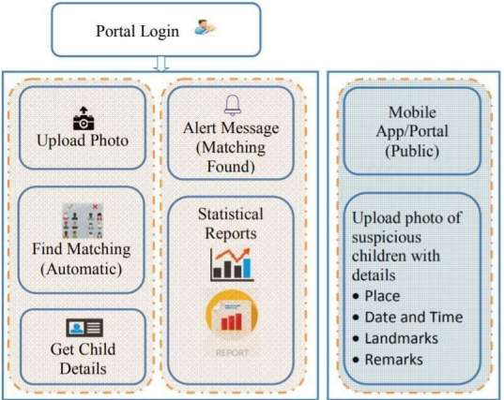
System Architecture

Slide 11
Software Requirements Specification (SRS)

Slide 12
Software Requirement (SRS)
Operating system : Windows 10
Coding Language : python
Tool : PyCharm
Database : MYSQL
Server : Flask

Slide 13
Hardware Requirement
System : Pentium Dual Core.
Hard Disk : 120 GB.
Monitor : 15’’ LED
Input Devices : Keyboard, Mouse
Ram : 1 GB

Slide 14
Application Modules
Module -1 :
Admin Module-where admin can train the model and check the status of the missing child in the whether the child will found in the database or not.
Module -2: public can upload the details in this screen
If any child is found that is a suspected child,can update in this screen with location,person,childname,contact number,photo of the suspected child

Slide 15
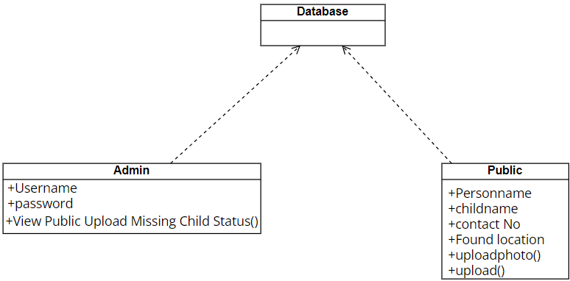
Class Diagram

Slide 16
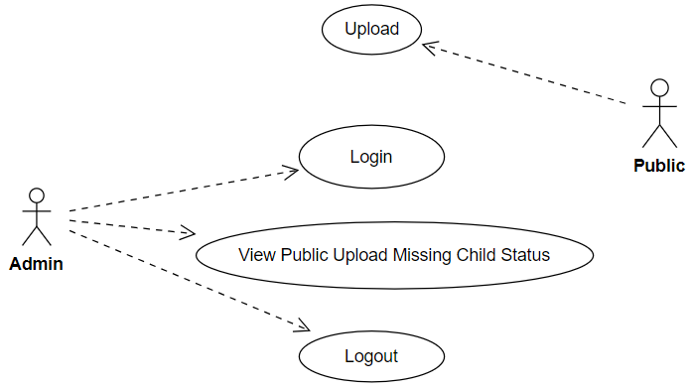
Use-Case Diagram

Slide 17
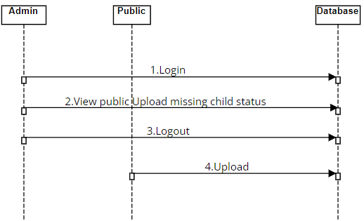
Sequence Diagram

Slide 18
About your Application
A missing child identification system is proposed, which combines the powerful CNN based deep learning approach for feature extraction and support vector machine classifier for classification of different child categories.
This system is evaluated with the deep learning model which is trained with feature representations of children faces. By discarding the softmax of the VGG-Face model and extracting CNN image features to train a multi class SVM, it was possible to achieve superior performance.
Performance of the proposed system is tested using the photographs of children with different lighting conditions, noises and also images at different ages of children.
The classification achieved a higher accuracy of 99.41% which shows that the proposed methodology of face recognition could be used for reliable missing children identification.

Slide 19
Status of the Application Development
The current status of the application development 40%-50% is finished

Slide 20
Tentative Date of Application Completion
- 15th october,2023

Slide 21
Thank you
L.Vaishali
M.Poojitha
T.Sai Kumar Reddy

